Slide 1
Social Media and the Rise of Dark Horse Candidates
Yotam Shmargad
Assistant Professor
University of Arizona
Limin Zhang
Doctoral Student
University of Arizona

Slide 2
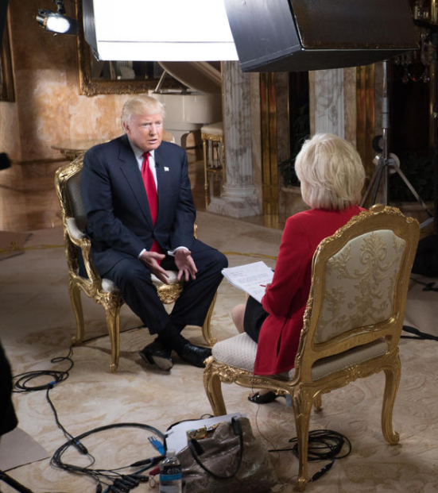
“I think that social media has more power than the money they spent, and I think maybe to a certain extent, I proved that.”
Google Search
2

Slide 3
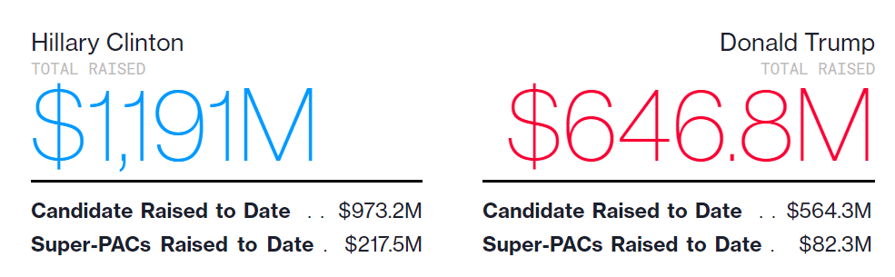
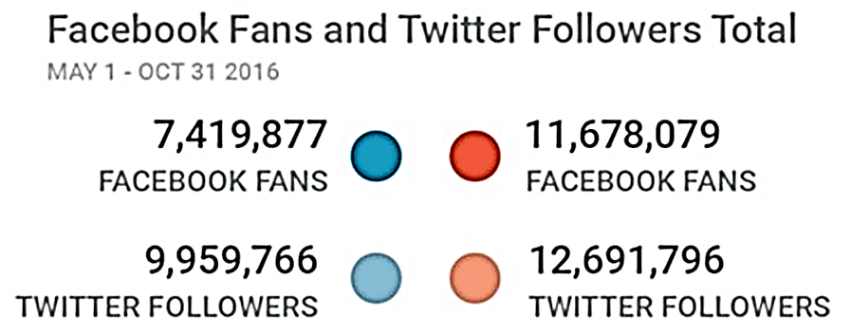
Indeed, Trump’s campaign raised less money than Clinton’s but performed better on social media
Money raised
Source: https://www.bloomberg.com/politics/graphics/2016-presidential-campaign-fundraising/
Social metrics
Source: https://memeburn.com/2016/11/hillary-clinton-donald-trump-twitter-facebook/
3

Slide 4
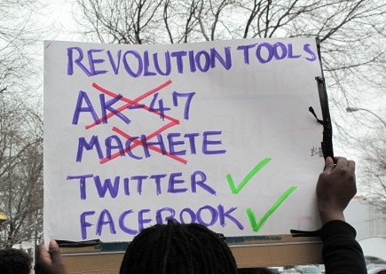

There is debate about whether social media can help political groups overcome financial shortcomings
Research on social movements
Social media can dampen financial inequalities by decreasing the costs of participation (e.g. Earl & Kimport 2011)
Social media exacerbate financial inequalities because of learning costs (e.g. Schradie 2018)
4

Slide 5
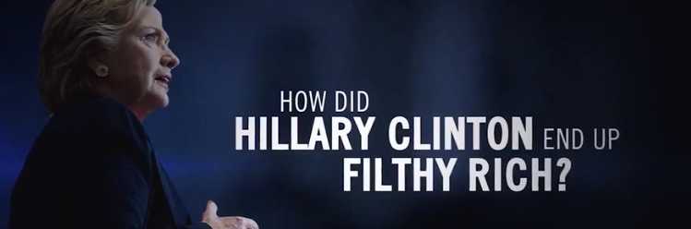


Political scientists care about what campaigns can do to overcome shortcomings
Research on campaigns
Negative ads are more effective for challengers than incumbents (e.g. Lau and Pomper 2002)
Campaign spending may be more effective for challengers (e.g. Jacobson 1990), though this has been debated (e.g. Gerber 1998)
Certain social networks can help campaigns with fewer resources to succeed (Klar and Shmargad 2017)
5

Slide 6
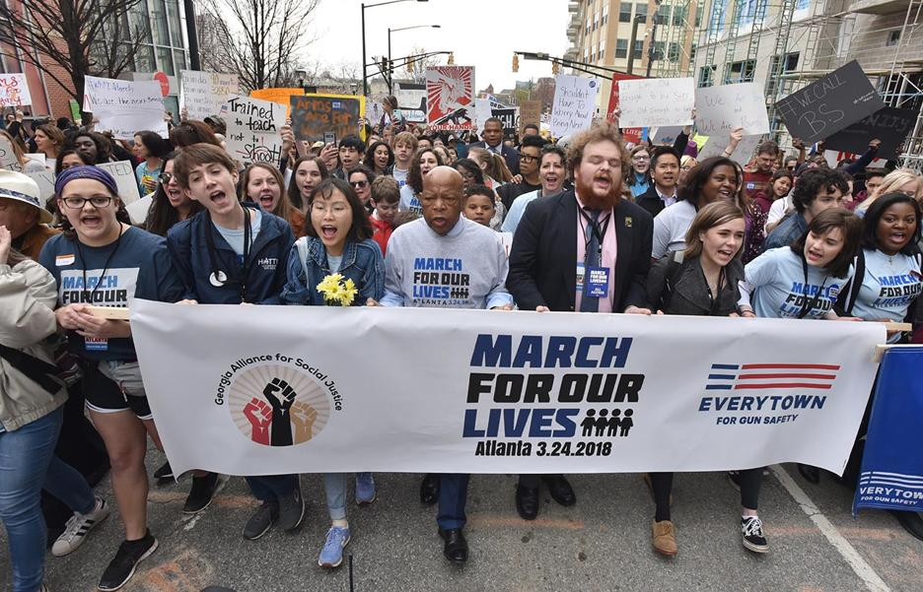
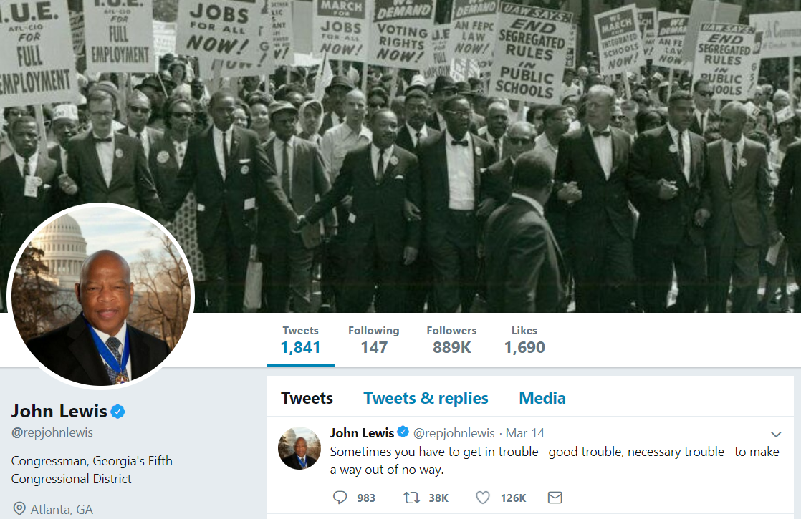
Did social media play an equalizing role in the 2016 U.S. congressional elections?
What I’ll show you today
Financial underdogs can close the electoral outcome gap if their messages are shared by popular users
There is no similar effect for financially-dominant candidates
Retweets
Likes
6

Slide 7
The plan for today
Motivation
Method
Results
Implications

Slide 8



To study congressional elections, I link data from the Federal Election Commission, Dataverse, and Twitter
Data sources
1) Campaign expenses and other candidate data
2) Outcomes of house and senate elections
3) Data about candidates’ Tweets and Retweeters

Slide 9

In order to collect Twitter data, I wrote a script that snowballs out from a candidate’s Twitter account
Twitter sampling method
Retweeters
Tweet
Tweet
Tweet
Candidate
Tweet
Tweet
Tweet
Tweet
Tweet
Tweet
Tweet
9

Slide 10
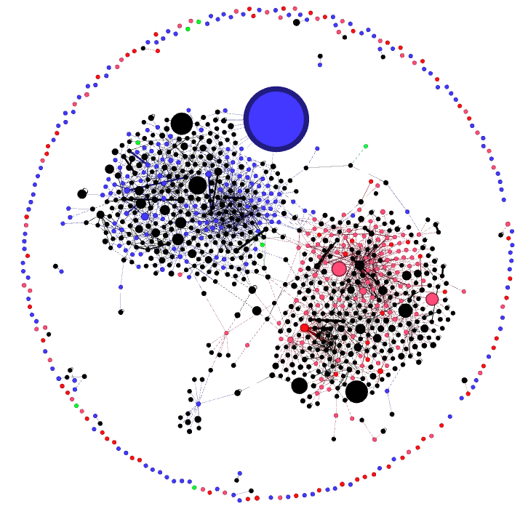
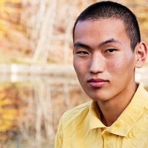
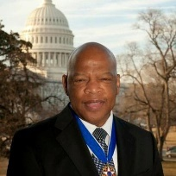
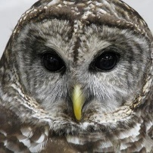
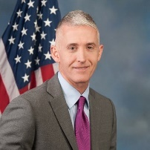
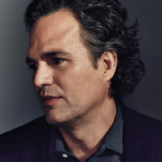
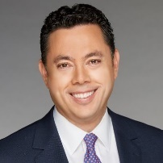
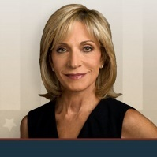
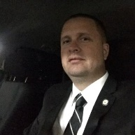

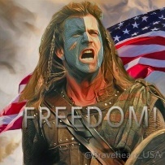
@nick2crosby
@repjohnlewis
GA-5
@MaddowBlog
@TGowdySC
SC-4
@jasoninthehouse
UT-3
@MarkRuffalo
@mitchellreports
Interactive Visualization: www.yotamshmargad.com/congress2016
@ChatRevolve
@NubianAwakening
@Braveheart_USA
10

Slide 11
Students in my Computational Social Science class helped with the data collection for this project
Class assignments
1) Collect vote shares of the top two candidates in several electoral races using Wikipedia: 263 races total
2) Find candidate Twitter handles: 406 candidates total
3) Collect candidate tweet data from August 3rd to November 8th with Twitter’s API (and UA’s high performance computing servers)
~ 25K candidate tweets
~ 900K retweeter tweets
~ 190K retweeters of candidate tweets
~ 1.3M retweeters of retweeters
I then combined these data with FEC data on campaign expenses
11

Slide 12
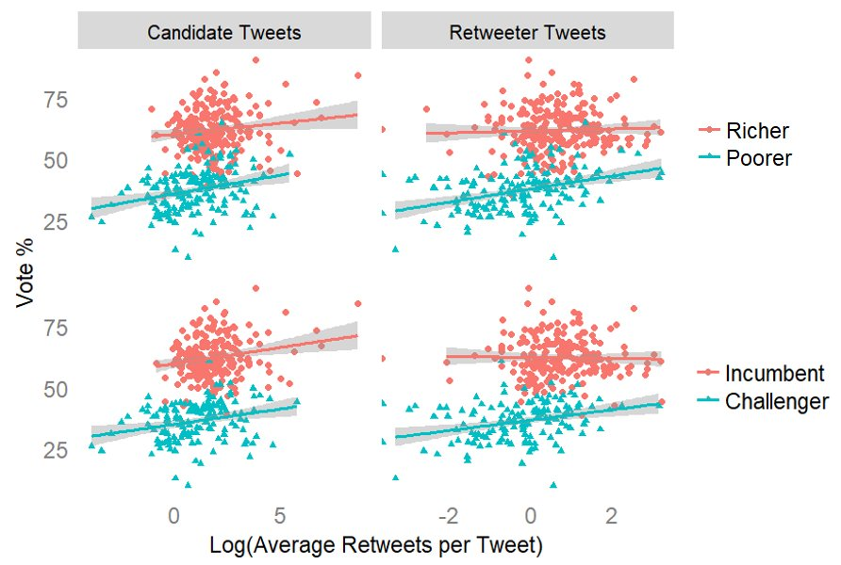
Retweets from popular users are positively associated with votes for poorer candidates and challengers
Vote % by retweets and candidate status
12

Slide 13
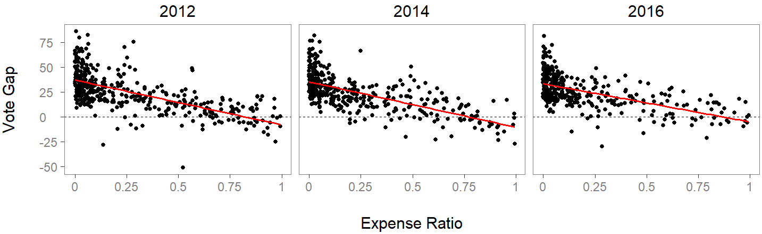
Races with more equal expenses saw more equal electoral outcomes
Expense Ratio:
Vote Gap:
$ of poorer candidate
$ of richer candidate
Vote % of richer candidate –
Vote % of poorer candidate
Equal outcome
Financially unequal race
Financially equal race
13

Slide 14
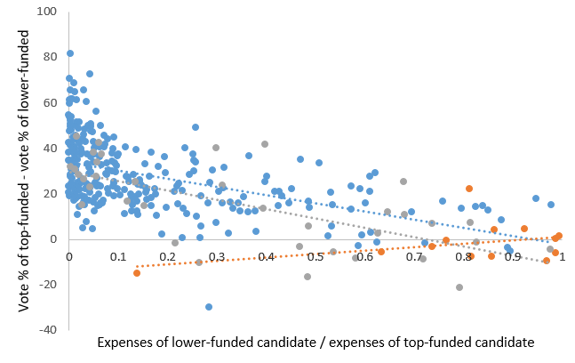
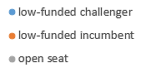
The relationship between money and votes in 2016 is flat when the poorer candidate is the incumbent
The effect of incumbency in 2016
Richer incumbent
Poorer incumbent
Open seat
Vote Gap
Expense Ratio
14

Slide 15
I model electoral outcomes at both the candidate and race levels
Candidate-level models
Vote % = α + β x Underdog
+ Γ x Twitter metrics and controls
+ Δ x Underdog x Twitter metrics and controls
+ State fixed effects + ε
Race-level models
Vote Gap = α + β x Expense Ratio
+ Γ x Twitter metrics and controls
+ Δ x Expense Ratio x Twitter metrics and controls
+ State fixed effects + ε
15

Slide 16
The plan for today
Motivation
Method
Results
Implications

Slide 17
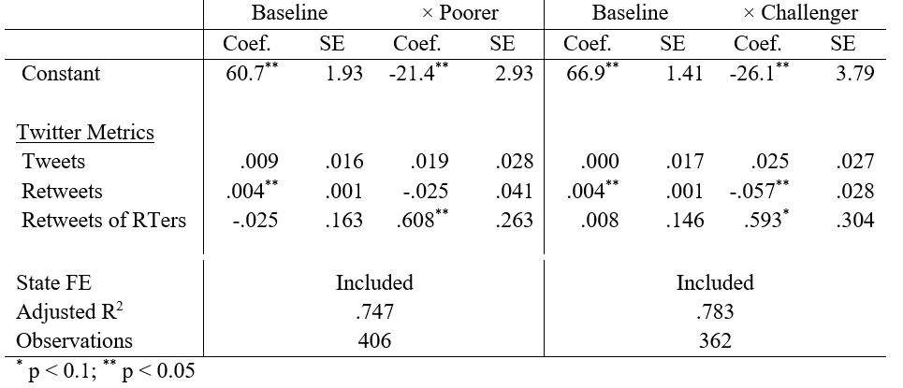
Retweets from popular Twitter users matter more for underdog candidates
Candidate-level models
Additional controls: Senate, Party, CNN mentions, Campaign Expenses
17

Slide 18
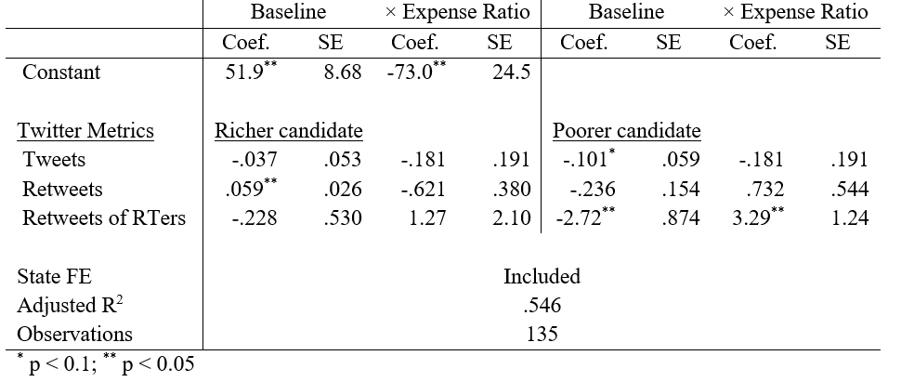
Retweets from popular users help poor candidates close the vote gap in financially unequal races
Race-level model of Vote Gap in 2016
Additional controls: Senate, Party, CNN mentions, Total Race Expenses
18

Slide 19
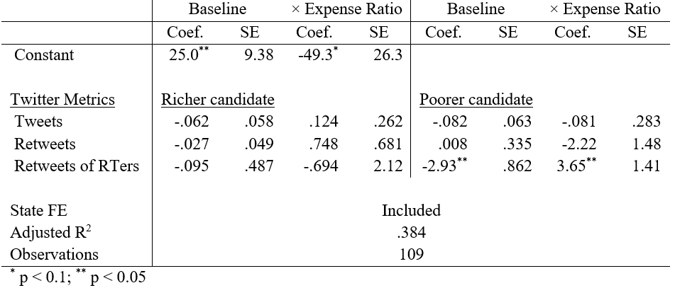
When comparing to the vote gap in 2014, only the popularity of poorer candidates’ retweeters matter
Race-level model of Vote Gap in 2016 - 2014
Additional controls: Senate, Party, CNN mentions, Total Race Expenses
19

Slide 20
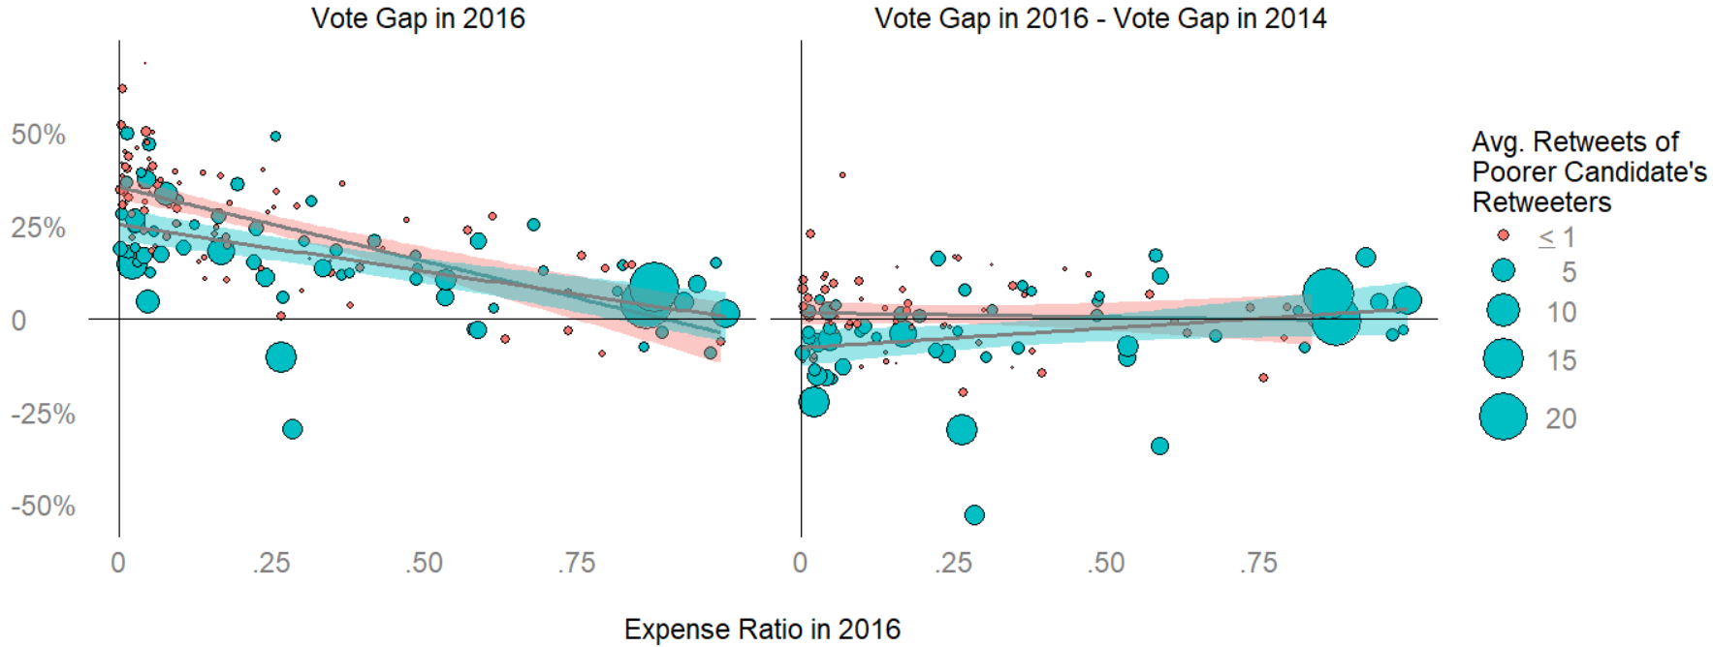
Retweets from popular users help poorer candidates close the vote gap, even when compared to 2014
Vote gap in 2016 and when compared to 2014
20

Slide 21
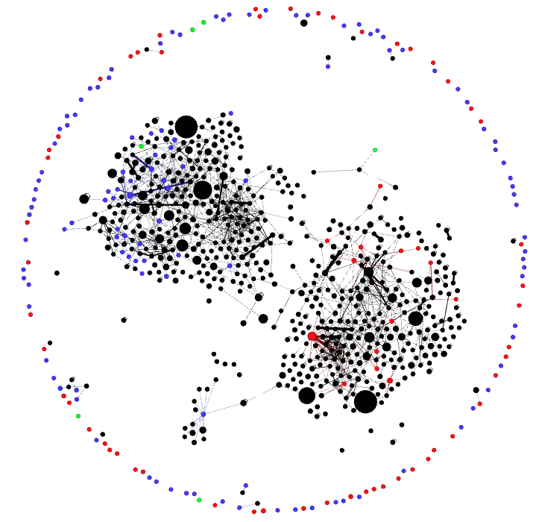
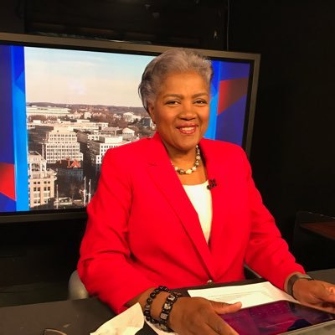
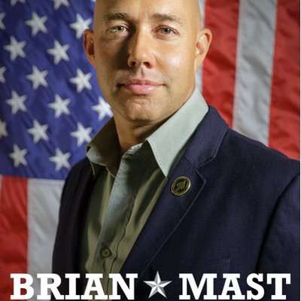
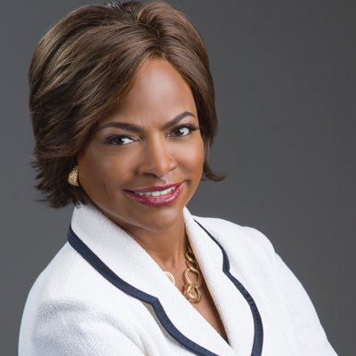

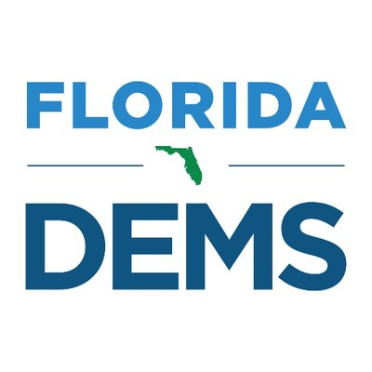
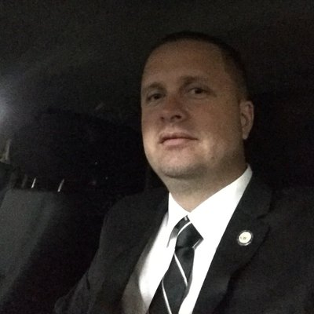
Total Race Expenses: 2.9M
Expense Ratio: 26%
Won by: 10 points
@donnabrazile
@BrianMastFL
FL-18
@val_demings
FL-10
@Braveheart_USA
@FlaDems
Total Race Expenses: 14K
Expense Ratio: 28%
Won by: 30 points
@ChatRevolve
21

Slide 22
The plan for today
Motivation
Method
Results
Implications

Slide 23
Money is still the best equalizer, but Twitter can help explain the success of poorer candidates
Ongoing research
Can Twitter help political candidates increase donations?
Does money help political candidates gain engagement from popular Twitter users?
23

Slide 24
There are a host of open questions regarding why endorsements from popular Twitter users matter
Future research
Do popular users simply broaden exposure to candidate’s message, or are they adding legitimacy?
Are popular users giving local issues a national audience, or aligning local candidates with national agendas?
Do endorsements only matter for messages that focus on a competitor’s weaknesses (i.e. negative ads), or can they also highlight a candidate’s own accomplishments?
24

Slide 25
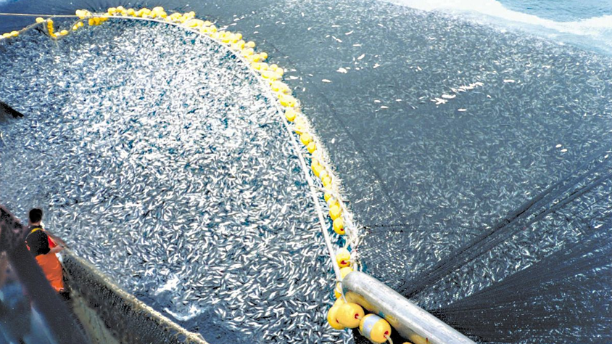
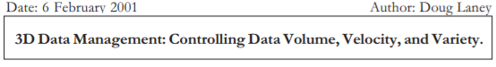
I study implications of Big Nets – the large, dense, and diverse networks afforded by social media
Degree
Density
Diversity
How social media influencers alter political processes
How densification decreases privacy to deter interaction
How context can shape reactions to political diversity
25

Slide 26
Social Media and the Rise of Dark Horse Candidates
Yotam Shmargad
Assistant Professor
University of Arizona
yotam@email.arizona.edu

Slide 27
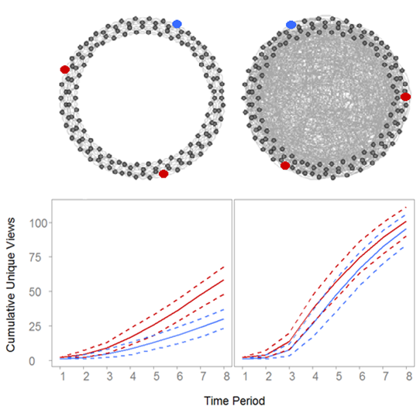
Certain networks can help campaigns with limited resources succeed (Klar and Shmargad 2017)
Network Experiment
Clustered lattice
Random network
assigned participants to different networks
asymmetrically seeded opposing political views
Results: Random networks
dampen inequality in exposure to messages
increase learning about issues and support for the low-seeded view
27

Slide 28
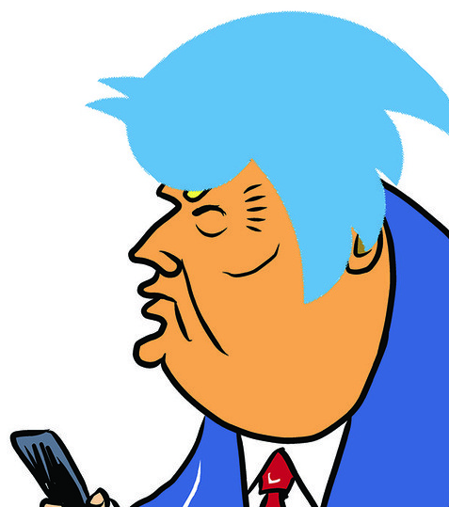

A candidate’s retweet network includes both their retweeters and retweeters of their retweeters
Edges have weights w_{ij} – the number of j’s posts that i has retweeted
2
w₂₁
1
w₂₃
w₃₂
w₃₁
Retweeters may retweet each other, so that we can compute network metrics
3
28

Slide 29
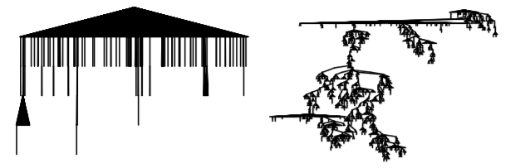
The metrics that matter on Twitter mimic traditional media, though potentially apply to new actors
Broadcasts vs. Contagion
In an analysis of more than 1 billion diffusion cascades on Twitter, Goel et al. (2016) show that popularity is usually driven by large broadcasts not contagion
Findings from Klar and Shmargad (2017) may be more applicable to contagion among elites
29

Slide 30
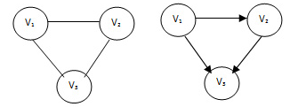
Correlates of success on Twitter may depart from traditional social network theories
Reconsidering secondhand effects
Burt (2010) shows that knowing well-connected people has little effect on success, but secondhand retweets play in important role here
In a book chapter on digital marketing, I argue that ideological capital is better than social capital for describing the value accrued from online interaction
Social capital
Based on trust
Usually reciprocal
Geographically-bound
Ideological capital
Based on shared beliefs
Often impersonal
Geographically-dispersed
30

